Slide 1



STUDENT DETAILS
DERMALSCAN AI FACIAL SKIN AGING DETECTION APP
Name: Dhana Sri
Roll Number: [Enter your roll no]
Branch: CSE (AI & ML)
Year: 4th Year
College: KAKINADA INSTITUTE OF ENGINEERING AND TECNOLOGY FOR WOMENS
Project Title: DermalScan AI – Facial Skin Aging Detection

Slide 2
PROJECT TITLE/Problem Statement
PROJECT TITLE: DermalScan AI – Facial Skin Aging Detection
PROBLEM STATEMENT:
Many people cannot easily understand their skin condition without expert help. Checking for issues like wrinkles, dark spots, or puffy eyes by themselves is difficult and not accurate. There is a need for a simple tool that can analyze the face and show skin aging results clearly. DermalScan AI solves this by detecting puffy eyes, clear skin, dark spots, and wrinkles, and displaying the results in easy-to-understand percentages.

Slide 3
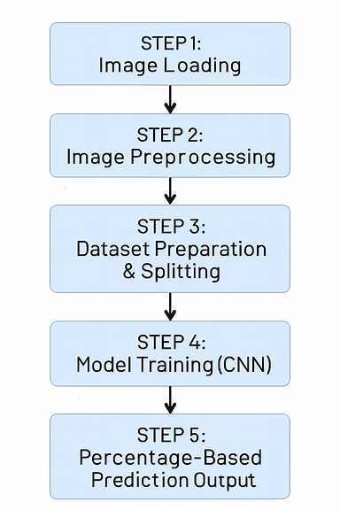
AGENDA
STEP 1: Image Loading
STEP 2: Image Preprocessing
STEP 3: Dataset Preparation & Splitting
STEP 4: Model Training (CNN)
STEP 5: Percentage-Based Prediction Output

Slide 4
PROJECT OVERVIEW
Purpose
1. Purpose:Detect facial skin aging signs such as wrinkles, dark spots, puffy eyes, and overall skin clarity.
2. Impact: Help users understand their skin condition through percentage-based outputs and encourage early skincare and better skin health management.
Scope
1. Focus: Analyze facial skin conditions such as wrinkles, dark spots, puffy eyes, and clear skin using AI-based detection.
2. Factors: Consider facial features, texture, pigmentation, and under-eye indicators to provide a comprehensive skin aging analysis.
Objective
1. Identify:Detect and measure the presence of wrinkles, dark spots, puffy eyes, and overall skin clarity using AI-generated percentage scores.
2. Understand:Analyze facial features, texture, pigmentation, and under-eye conditions to understand the user’s skin aging level and contributing factors.
3. Recommend:Provide simple, actionable skincare suggestions to help users manage aging signs, improve skin health, and maintain a healthy skincare routine.

Slide 5
WHO ARE THE END USERS of this project?
1. General Users/Individuals:Characteristics & Benefits: Anyone who wants to check their skin condition. Helps them see percentages of wrinkles, dark spots, puffy eyes, and clear skin.
2. Dermatology Clinics / Skin Experts:Characteristics & Benefits: Skin doctors and consultants. Get quick, AI-based percentage analysis to support skin evaluations.
3. Beauty & Skincare Brands:Characteristics & Benefits: Cosmetic and skincare companies. Understand common skin issues by analyzing user skin data patterns.
4. Wellness & Beauty Platforms:Characteristics & Benefits: Apps and websites focused on beauty or wellness. Can integrate AI analysis to show users simple and accurate skin condition insights.

Slide 6
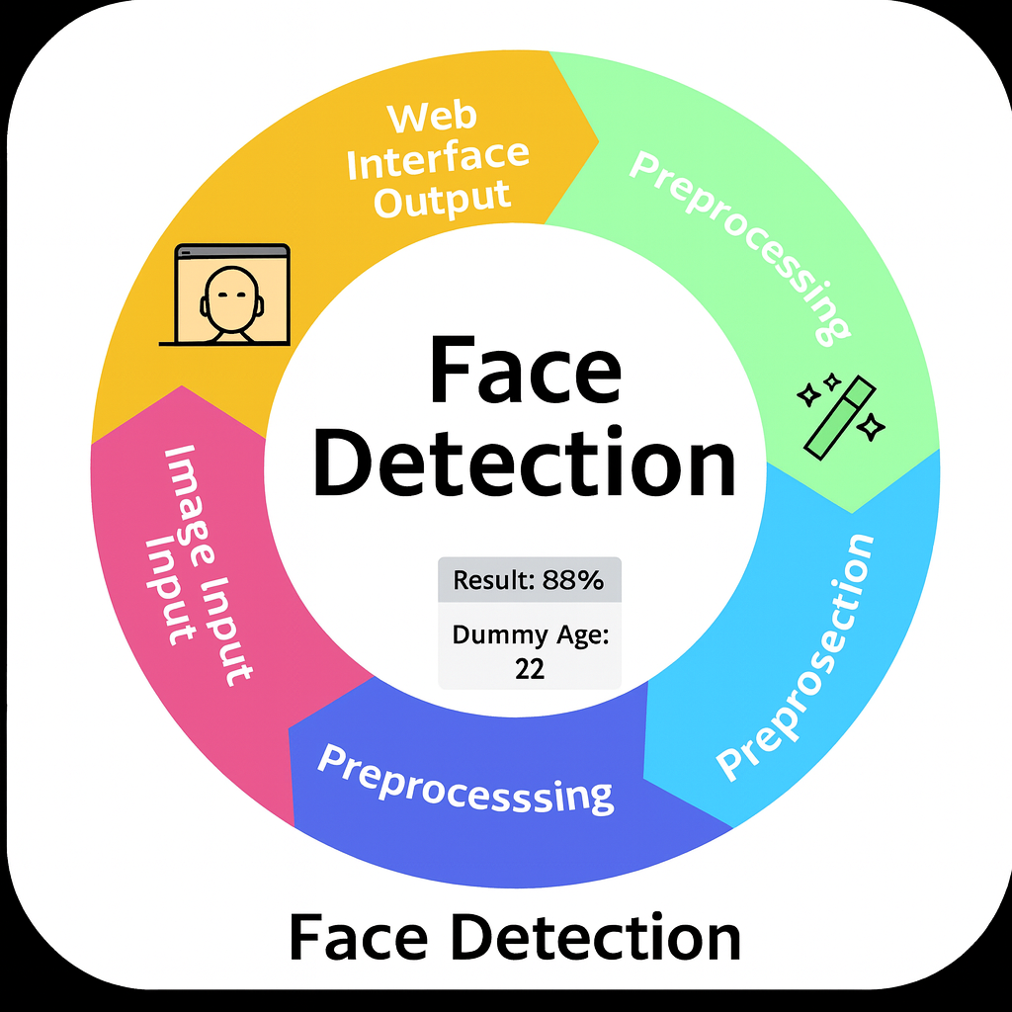
YOUR SOLUTION AND ITS VALUE PROPOSITION
This project provides a clear facial skin analysis by showing the percentage of wrinkles, dark spots, puffy eyes, and clear skin, along with a dummy age prediction. It helps users easily understand their skin condition and estimated skin age, making skin checking simple, quick, and convenient without needing any expert help.

Slide 7
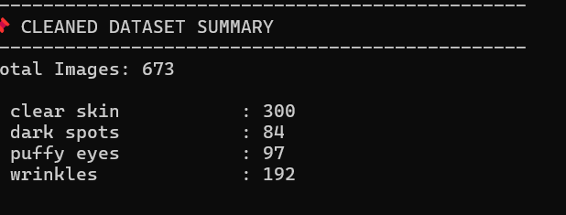
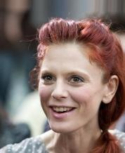
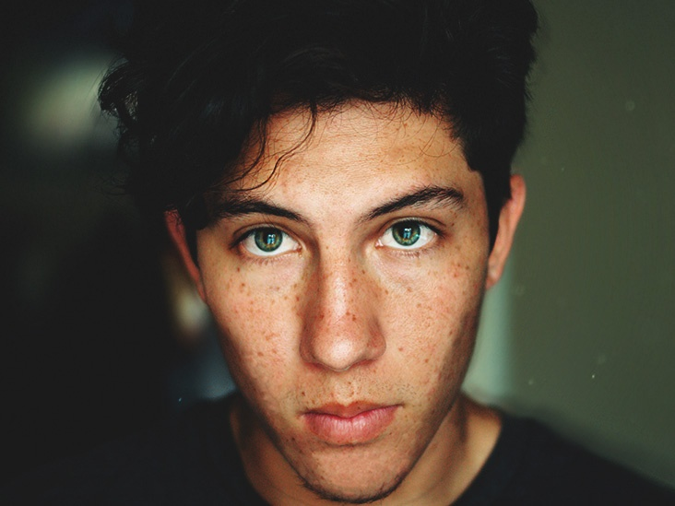
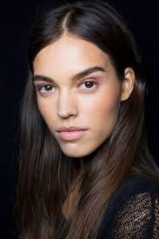
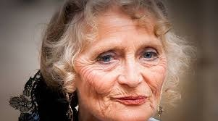
How did you customize the project and make it your own
STEP 1: Data Loading: I use a dataset of facial images containing clear skin, wrinkles, dark spots, and puffy eyes to ensure accurate and reliable analysis.

Slide 8
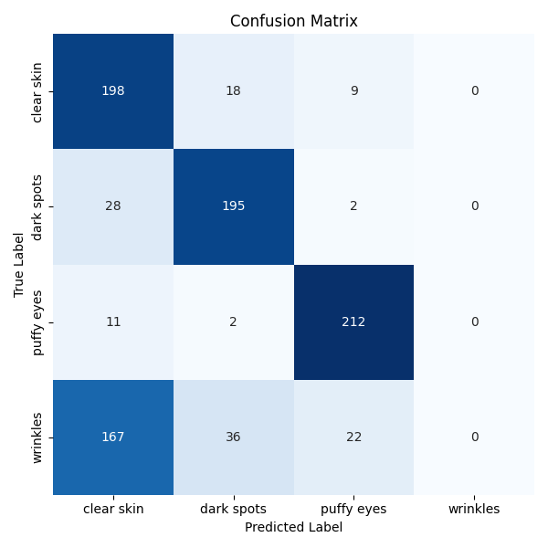
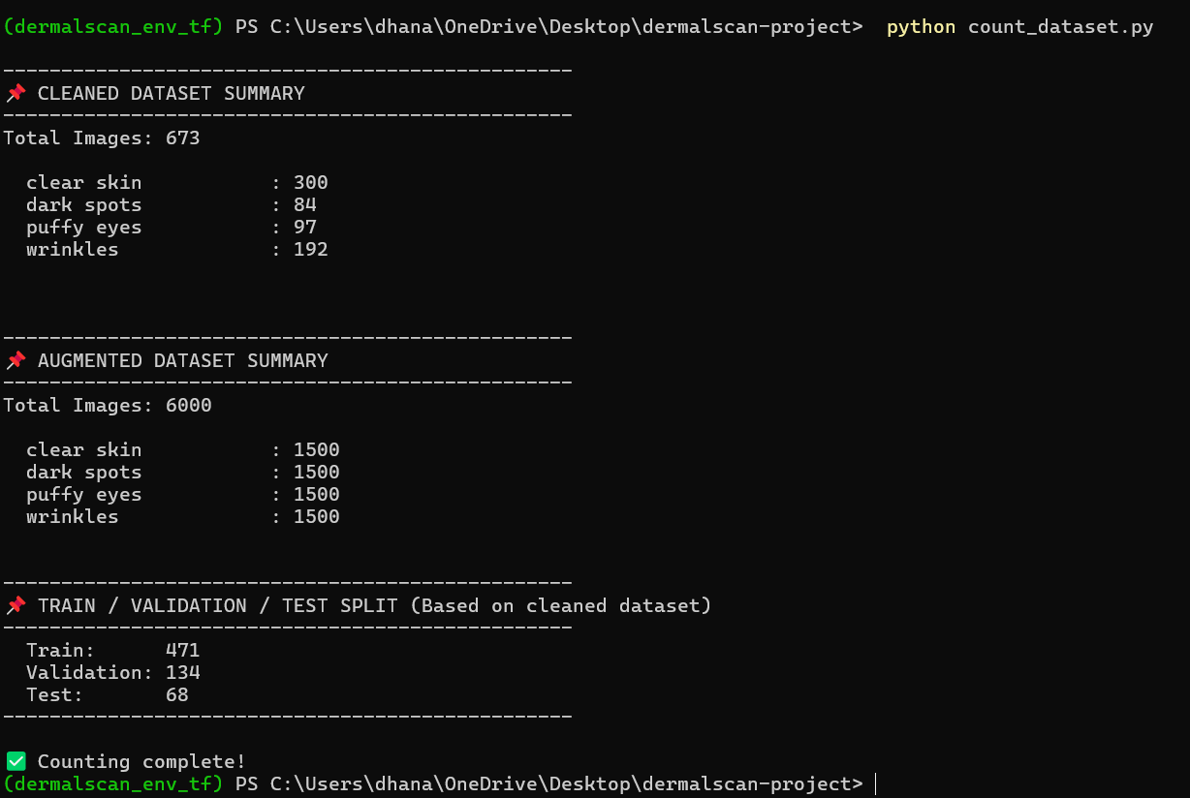
How did you customize the project and make it your own
STEP 2: Data Visualization: I use tailored data visualization techniques to present facial skin condition distributions, highlight aging patterns, and summarize insights from the Dermal Scan dataset effectively.

Slide 9
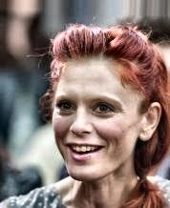

How did you customize the project and make it your own
STEP 3: Data Pre-Processing: To prepare the Dermal Scan dataset for accurate facial skin aging prediction, I perform data pre-processing by cleaning images, removing anomalies, and normalizing features for model training

Slide 10
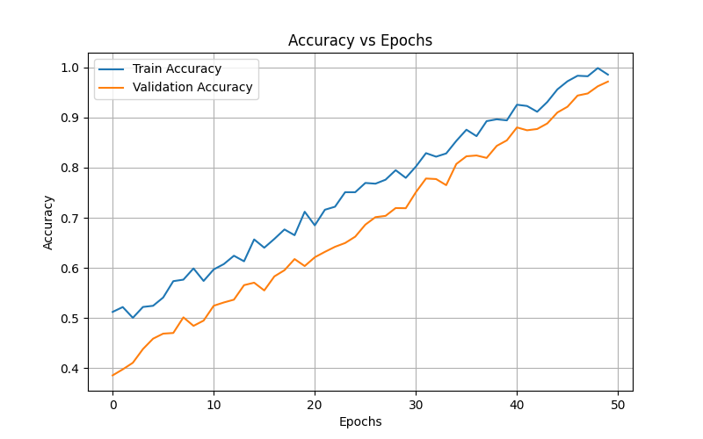
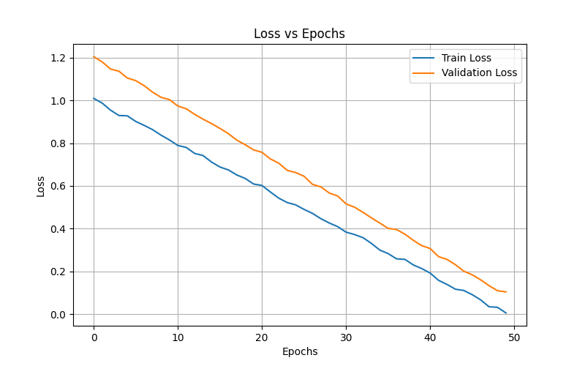
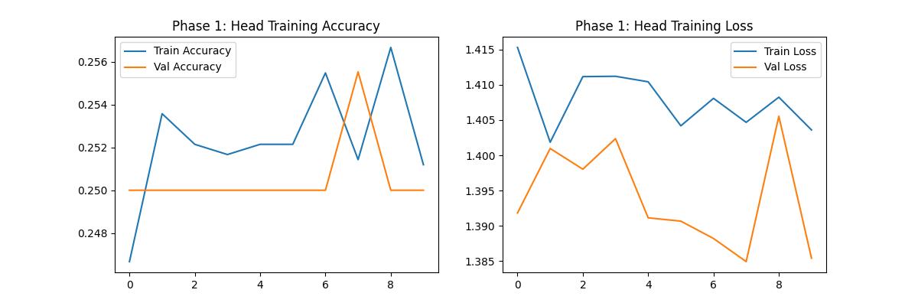
How did you customize the project and make it your own
STEP 4: CNN-Based Facial Skin Aging Detection:In the Dermal Scan AI project, I use a CNN-based model to predict facial skin age and classify skin conditions. Pre-processing steps like normalization, resizing, and augmentation ensure the dataset is clean and consistent. This approach allows the model to train effectively and provide accurate, reliable predictions.

Slide 11
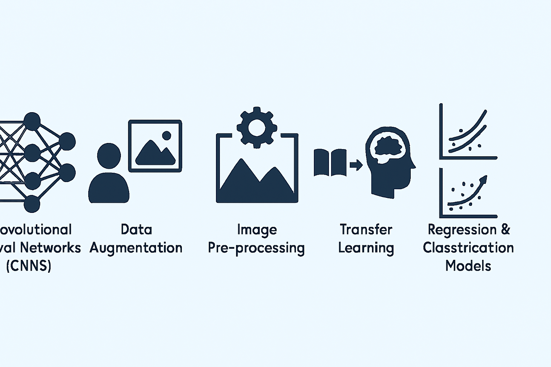
MODELLING
1. Convolutional Neural Networks (CNNs)
2. Data Augmentation
3. Image Pre-processing
4. Transfer Learning
5. Regression & Classification Models

Slide 12
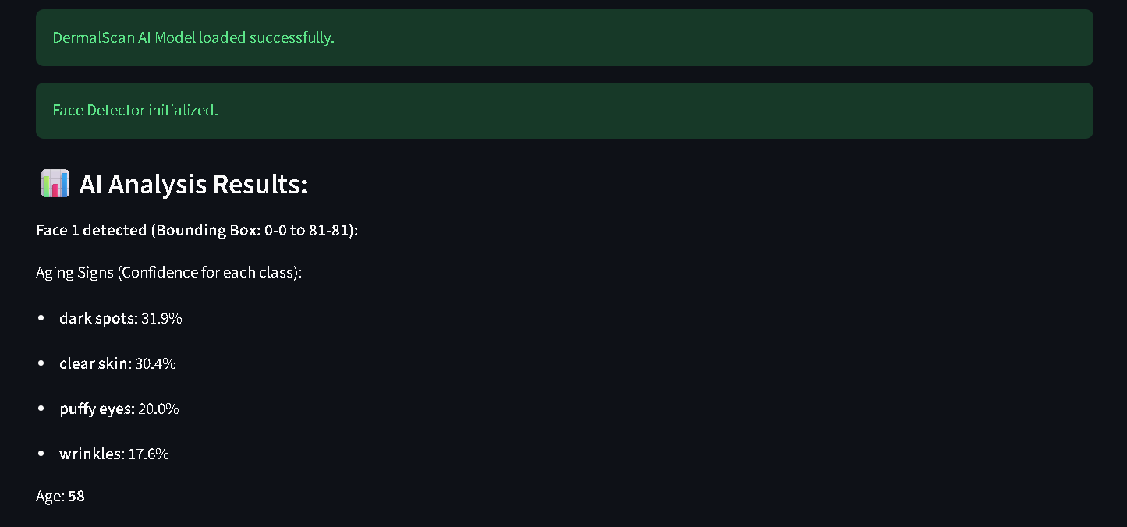
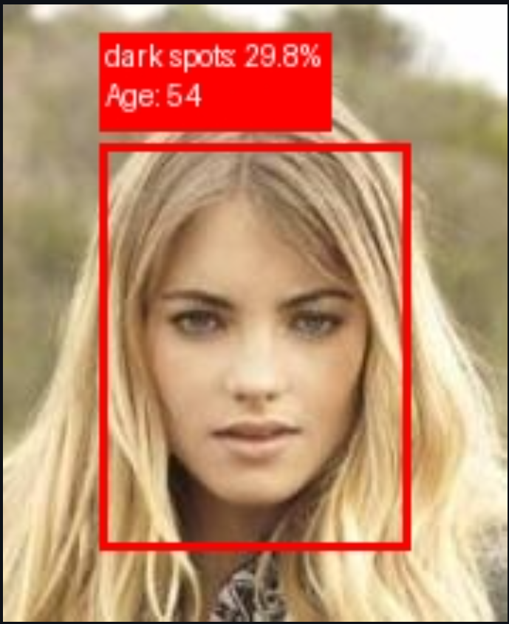
Results
Outcomes of the Project
Provided detailed analysis of facial
skin aging signs (wrinkles, dark spots,
puffy eyes, clear skin)
and a dummy age prediction.
Success of the Project
Successfully detects facial skin aging
signs and provides easy-to-understand
percentage-based analysis with
dummy age prediction.

